Slide 1
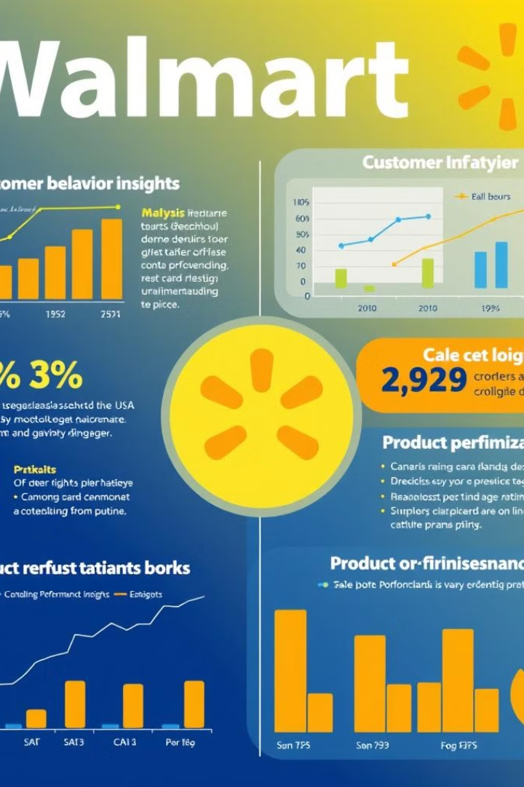
Sales Performance Analysis of Walmart Stores Using Advanced SQL Techniques
By
UMA MAHESWAR NETHI
DATA SCIENCE LEARNER

Slide 2
INTRODUCTION
Walmart, a major retail chain, operates across several cities, offering a wide range of products. The dataset provided contains detailed transaction data, including customer demographics, product lines, sales figures, and payment methods. This project will use advanced SQL techniques to uncover actionable insights into sales performance, customer behavior, and operational efficiencies.
The dataset used in this project contains information about Walmart's sales transactions, including customer demographics, product categories, purchase dates, and transaction amounts. The project objectives are to identify key trends and patterns in Walmart's sales data, provide actionable insights, and recommend strategies for improving sales performance.

Slide 3

Business Problem
Sales Analysis
Customer Behavior
Walmart needs to analyze its sales data to understand the factors driving sales growth, identify areas for improvement, and optimize pricing strategies.
Understanding customer behavior is crucial for Walmart to personalize marketing campaigns, improve customer satisfaction, and develop loyalty programs.
Product Performance
Analyzing product performance helps Walmart identify best-selling products, optimize inventory management, and make informed decisions about product assortment.

Slide 4
SQL TASKS IN THIS PROJECT
Task 1: Identifying the Top Branch by Sales Growth Rate
Task 2: Finding the Most Profitable Product Line for Each Branch
Task 3: Analyzing Customer Segmentation Based on Spending
Task 4: Detecting Anomalies in Sales Transactions.
Task 5: Most Popular Payment Method by City
Task 6: Monthly Sales Distribution by Gender
Task 7: Best Product Line by Customer Type
Task 8: Identifying Repeat Customers
Task 9: Finding Top 5 Customers by Sales Volume
Task 10: Analyzing Sales Trends by Day of the Week

Slide 5
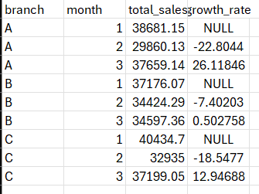
Top Branch By Sales Growth Rate
SQL Query
WITH top_Branch_by_Sales AS ( SELECT branch,
MONTH(date) AS month,
SUM(total) AS total_sales,
LAG(SUM(total)) OVER (PARTITION BY branch ORDER BY MONTH(date)) AS prev_month_sales
FROM walmart_sales
GROUP BY branch, MONTH(date))
SELECT branch, month, total_sales, (total_sales - prev_month_sales) / prev_month_sales * 100 AS growth_rate
FROM top_Branch_by_Sales;
OUT PUT

Slide 6
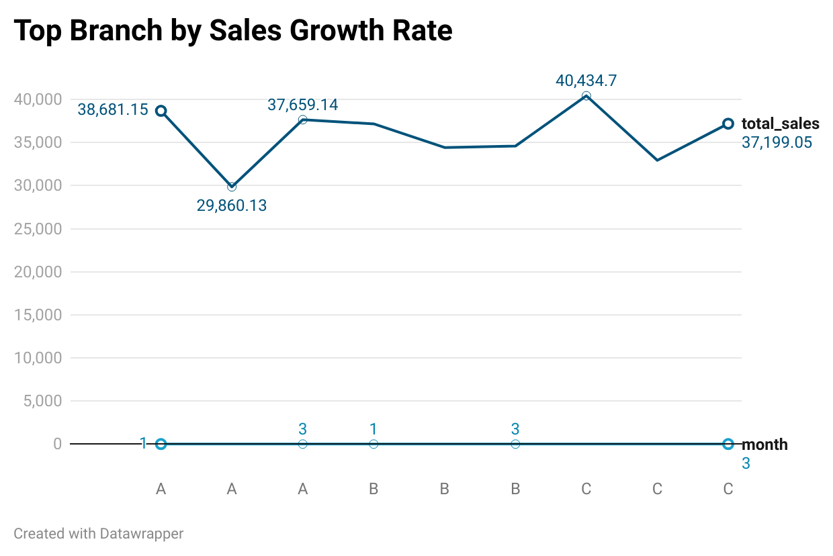
Top Branch By Sales Growth Rate
Create a Common Table Expression (CTE) named `top_Branch_by_Sales` to gather data for each branch by month.
Calculate `total_sales` for each branch and month combination.
Use the `LAG` function to retrieve the previous month's total sales (`prev_month_sales`) for comparison.
Calculate the month-over-month growth rate as the percentage change between the current month's total sales and the previous month's total sales.
Summary Output: Branch name, month of sales, total sales, and growth rate.
Line Chart: X-Axis for months, Y-Axis for total sales, lines representing each branch, data points for total sales, and slopes indicating growth rates.

Slide 7
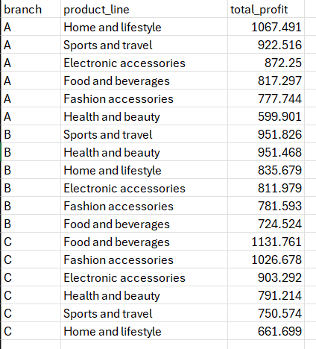
Profitable Product Line For Each Branch
SQL Query
SELECT branch, product_line, SUM(gross_income) AS total_profit
FROM sales
GROUP BY branch, product_line
ORDER BY branch, total_profit DESC;
OUT PUT

Slide 8
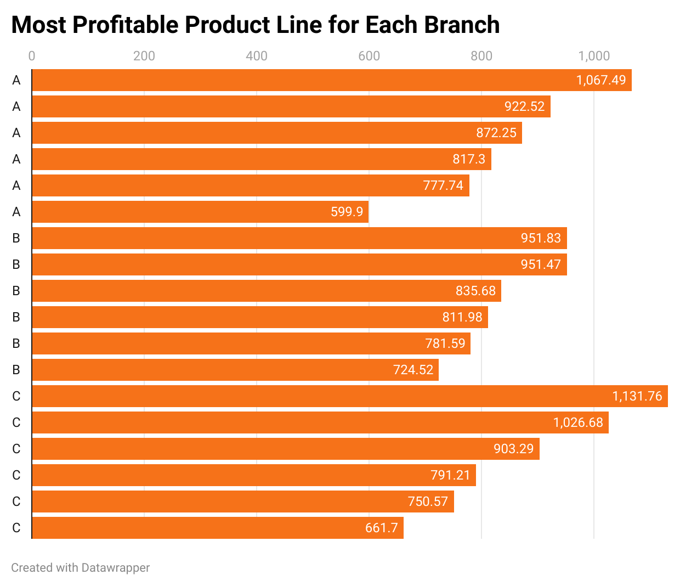
Profitable Product Line By Each Branch
1. Branch A:
- Highest total profit: 1,067.49
- Significant product lines contributing to profits: 922.52, 872.25, 817.3
2. Branch B:
- Highest total profit: 951.83
- Key product lines: 951.47, 835.68, 811.98
3. Branch C:
- Highest total profit: 1,131.76
- Major product lines: 1,026.68, 903.29, 791.21
4. Insights:
- Branch C leads with the highest overall profit.
- Branch A shows consistent high profits across multiple product lines.
- Branch B demonstrates steady profit levels.

Slide 9

Customer Segmentation by Spending
SQL Query
SELECT customer_type,
SUM(total) AS total_spent,
CASE
WHEN
SUM(total) >= 1000 THEN 'High Spender'
WHEN SUM(total)>= 500 then 'Medium Spender'
ELSE 'Low Spender'
END AS spend_categoryFROM walmart_salesGROUP BY customer_type;
Out put

Slide 10
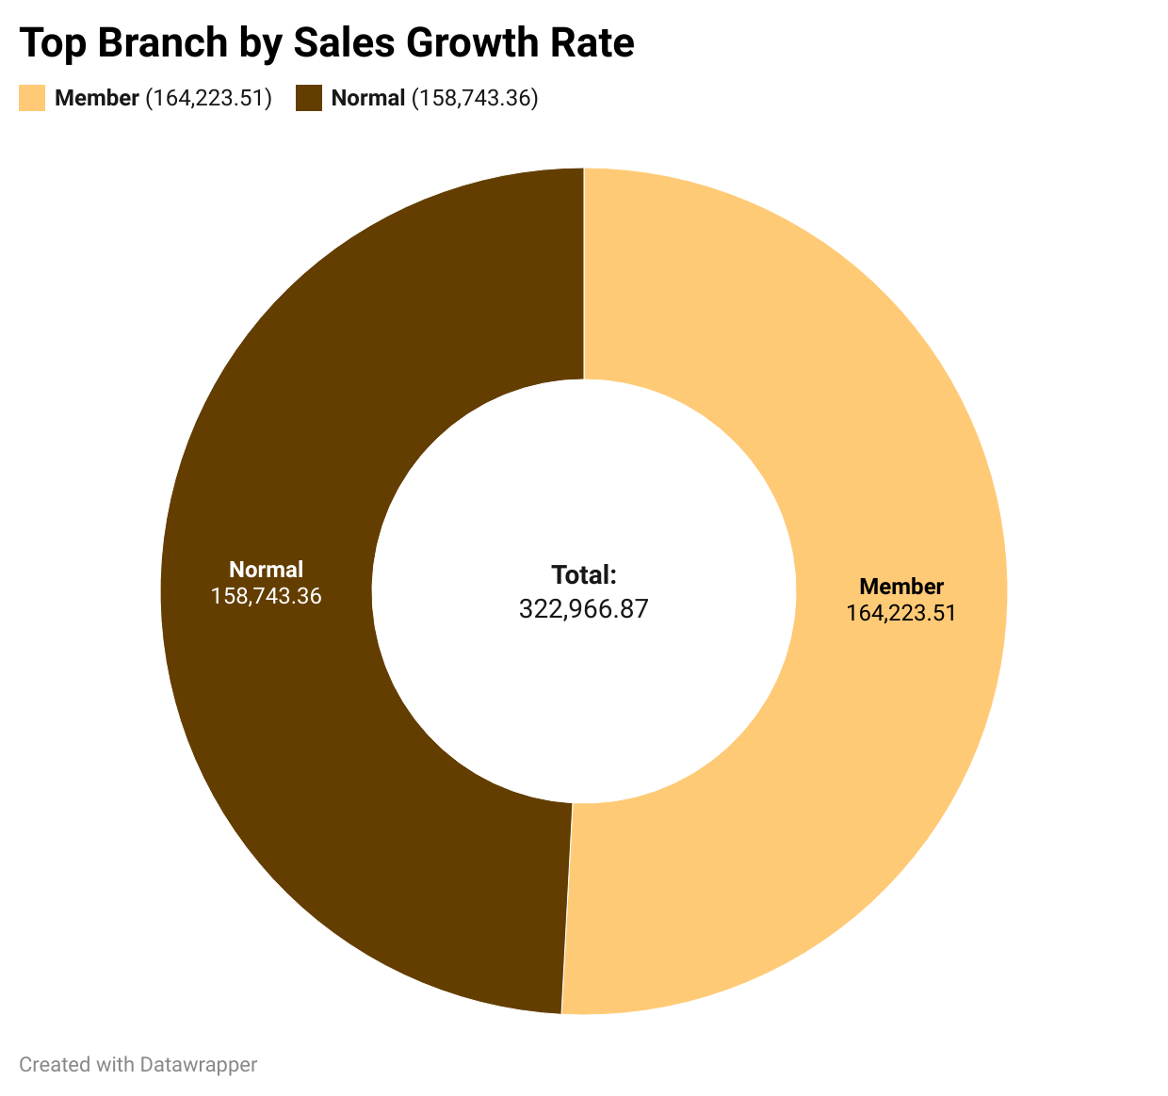
Customer Segmentation Based On Spending
Customer Types:
Member: This category is represented by the light orange segment on the chart.
Normal: This category is represented by the dark brown segment on the chart.
Spending Categories:
High Spender: Both Member and Normal customers are classified as "High Spenders" due to their total spent amount being above 1000.
Medium Spender: None of the customer types fall into this category for the given data.
Low Spender: None of the customer types fall into this category for the given data.
Total Spend:
Combined, the total spending for both customer types is 322,966.87.

Slide 11
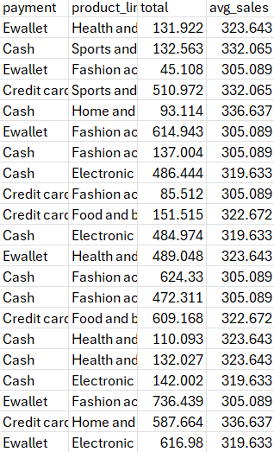
Anomalies Detection In Sales Transactions
SQL Query
SELECT payment, product_line,
ROUND(total, 3) AS total,
ROUND((SELECT AVG(total)
FROM walmart_sales
WHERE product_line = s.product_line), 3) AS avg_sales
FROM walmart_sales s
WHERE total > (SELECT AVG(total) * 1.5
FROM walmart_sales
WHERE product_line = s.product_line) OR
total < (SELECT AVG(total) * 0.5
FROM walmart_sales
WHERE product_line = s.product_line);
Out put
result rows as 569

Slide 12
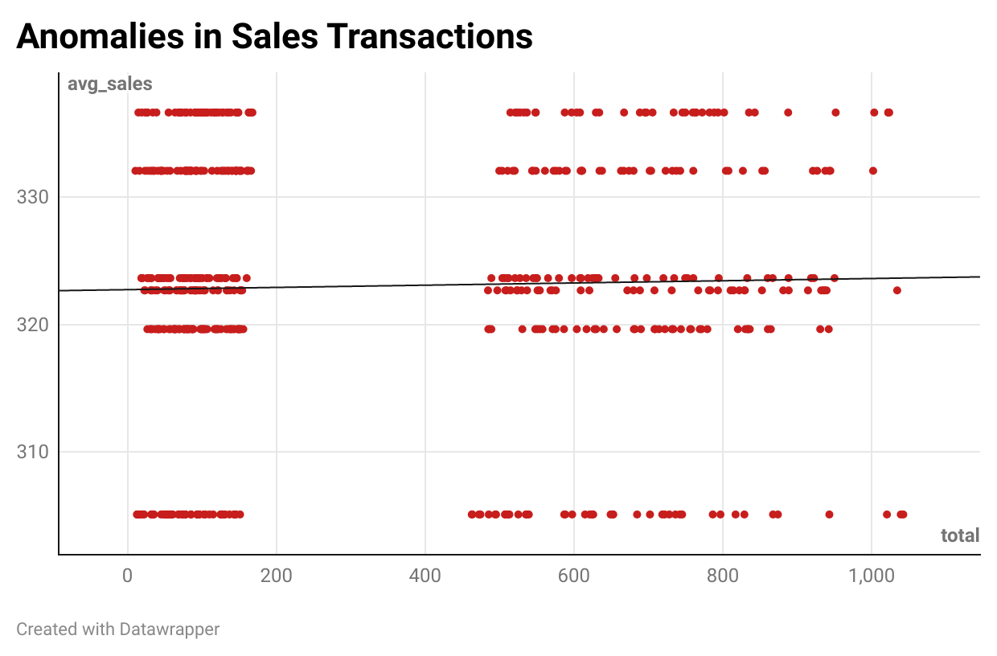
Anomalies Detection In Sales Transactions
Key Insights:
City-wise Breakdown: Identifies sales distribution across different locations.
Payment Method Usage: Determines the most preferred payment modes.
Sales Trends: Helps in analyzing customer behavior and transaction preferences.
Scatter Plots: Detecting anomalies in payment patterns.
Optimizing store payment options.
Targeted marketing for high-sale cities.
Identifying irregularities in transactions.

Slide 13
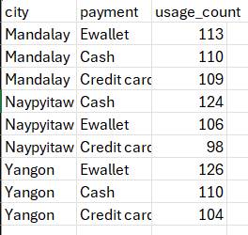
Popular Payment Method By City
SQL Query
SELECT city, payment, COUNT(*) AS usage_count
FROM walmart_sales
GROUP BY city, payment
ORDER BY city, usage_count DESC;
Out put

Slide 14
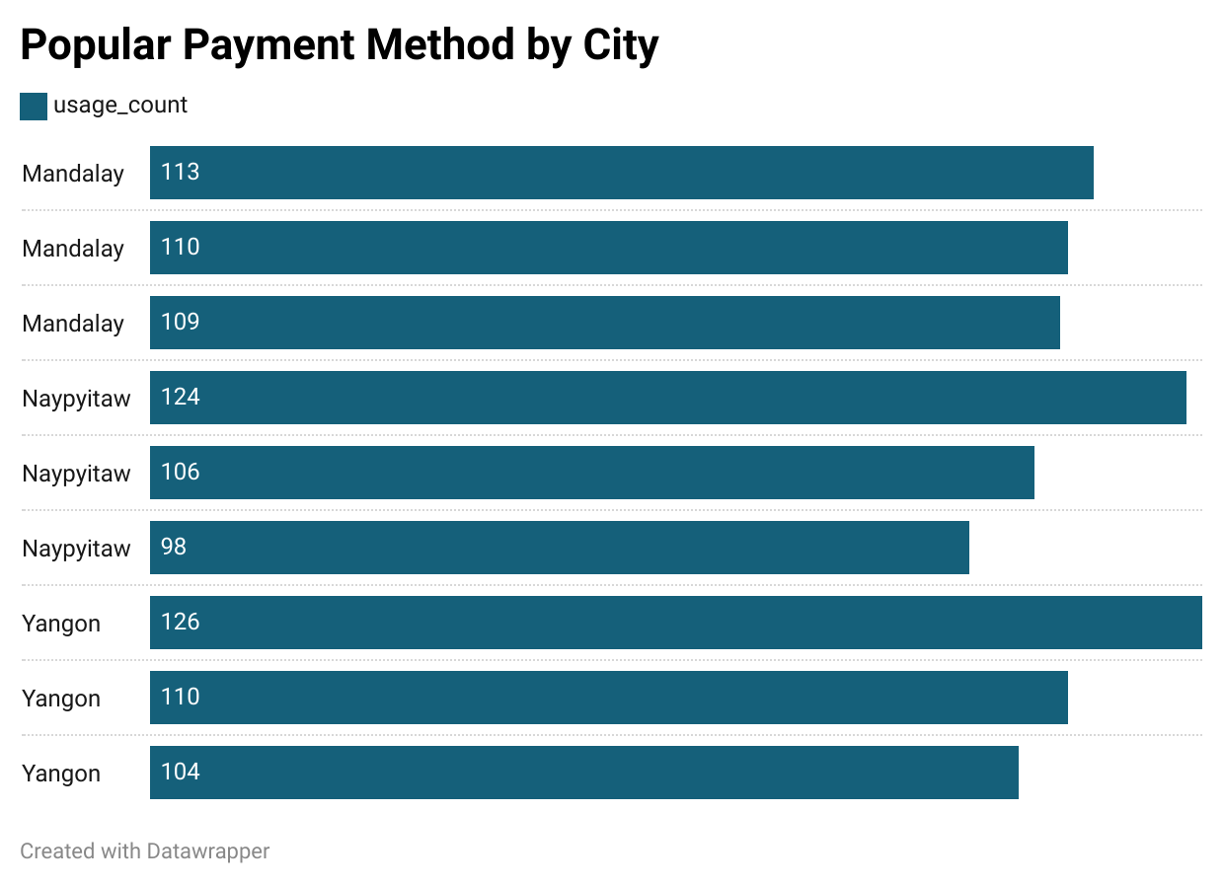
Popular Payment Method By City
Key Insights:
City-wise Payment Trends:
The most frequently used payment methods in Mandalay, Naypyitaw, and Yangon.
Helps in understanding customer preferences across different locations.
Top Findings:
Yangon has the highest transaction count for a single payment method.
Different cities exhibit varying payment trends, useful for business strategy.
Bar Chart: Shows the most used payment methods per city.
Helps in store-level decision-making for better customer experience.
Identifies the most used payment options for promotions and offers.
Useful for fraud detection and anomaly identification in transactions.

Slide 15
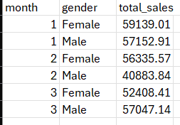
Monthly Sales Distribution By Gender
SQL Query
SELECT MONTH(date) AS month, gender, SUM(total) AS total_sales
FROM walmart_sales
GROUP BY month, gender
ORDER BY month;
Out put

Slide 16
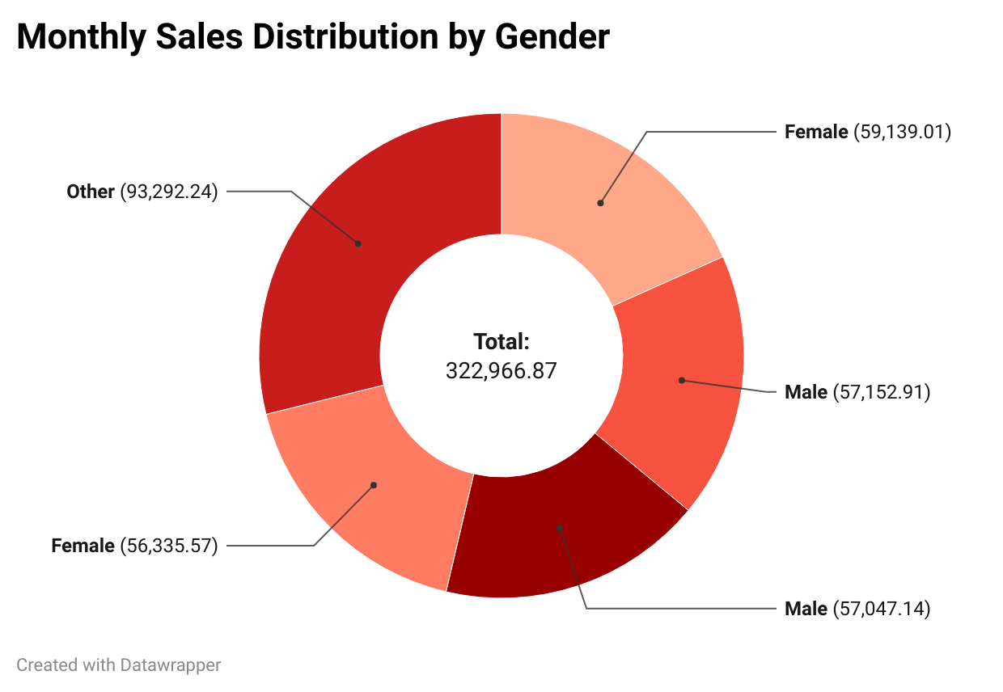
Monthly Sales Distribution By Gender
Key Insights:
Shows the distribution of product purchases based on customer type.
Helps in understanding customer preferences and shopping behavior.
Top Findings:
Identifies which customer types (Member, Normal, Other) prefer specific product lines.
Highlights potential customer segments for targeted promotions.
Donut Chart: Displays the proportion of purchases by customer type.
Table View: Summarizes product line distribution for each customer type.
Helps tailor product offerings to customer preferences.
Aids in designing loyalty programs for frequent buyers.
Supports data-driven marketing strategies to boost sales.

Slide 17
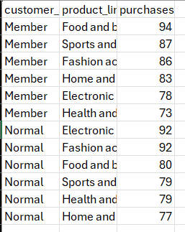
Best Product Line By Customer Type
SQL Query
SELECT customer_type, product_line, COUNT(*) AS purchases
FROM Walmart_sales
GROUP BY customer_type, product_line
ORDER BY customer_type,
purchases DESC;
Out put

Slide 18
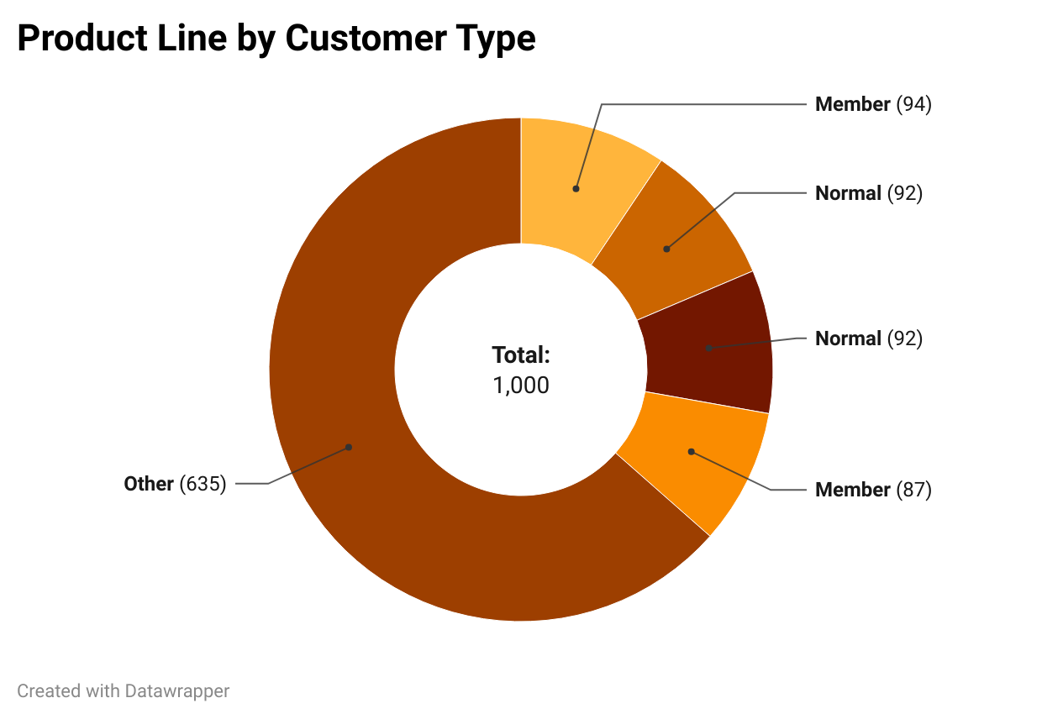
Best Product Line By Customer Type
Key Insights:
Provides a breakdown of total sales by gender on a monthly basis.
Helps in analyzing gender-based purchasing trends over time.
Top Findings:
Identifies which gender contributes more to overall sales.
Highlights seasonal or monthly variations in sales distribution.
Donut Chart: Represents sales contribution by gender.
Table View: Summarizes total sales for each gender per month.
Helps in designing gender-specific marketing campaigns.
Aids in product placement and promotional strategies.
Supports data-driven decision-making for sales optimization.

Slide 19
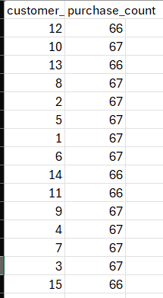
Identifying Repeat Customers
SQL Query
SELECT customer_id, COUNT(*) AS purchase_count
FROM Walmart_sales
WHERE date BETWEEN DATE_SUB(date, INTERVAL 30 DAY) AND date
GROUP BY customer_id
HAVING purchase_count > 1;
Out put

Slide 20
Identifying Repeat Customers
Key Insights:
Identifies repeat customers who have made more than one purchase in the last 30 days.
Helps in understanding customer retention and loyalty trends.
Top Findings:
Customers who shop frequently within a month.
Potential loyal customers for targeted promotions and discounts.
Segmentation: Helps identify high-value repeat customers.
Helps in designing loyalty programs for repeat buyers.
Optimizes personalized marketing campaigns for engaged customers.
Improves customer engagement strategies for higher retention.

Slide 21
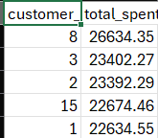
Top 5 Customers By Sales Volume
SQL Query
SELECT customer_id, SUM(total) AS total_spent
FROM sales
GROUP BY customer_id
ORDER BY total_spent DESC
LIMIT 5;
Out put

Slide 22
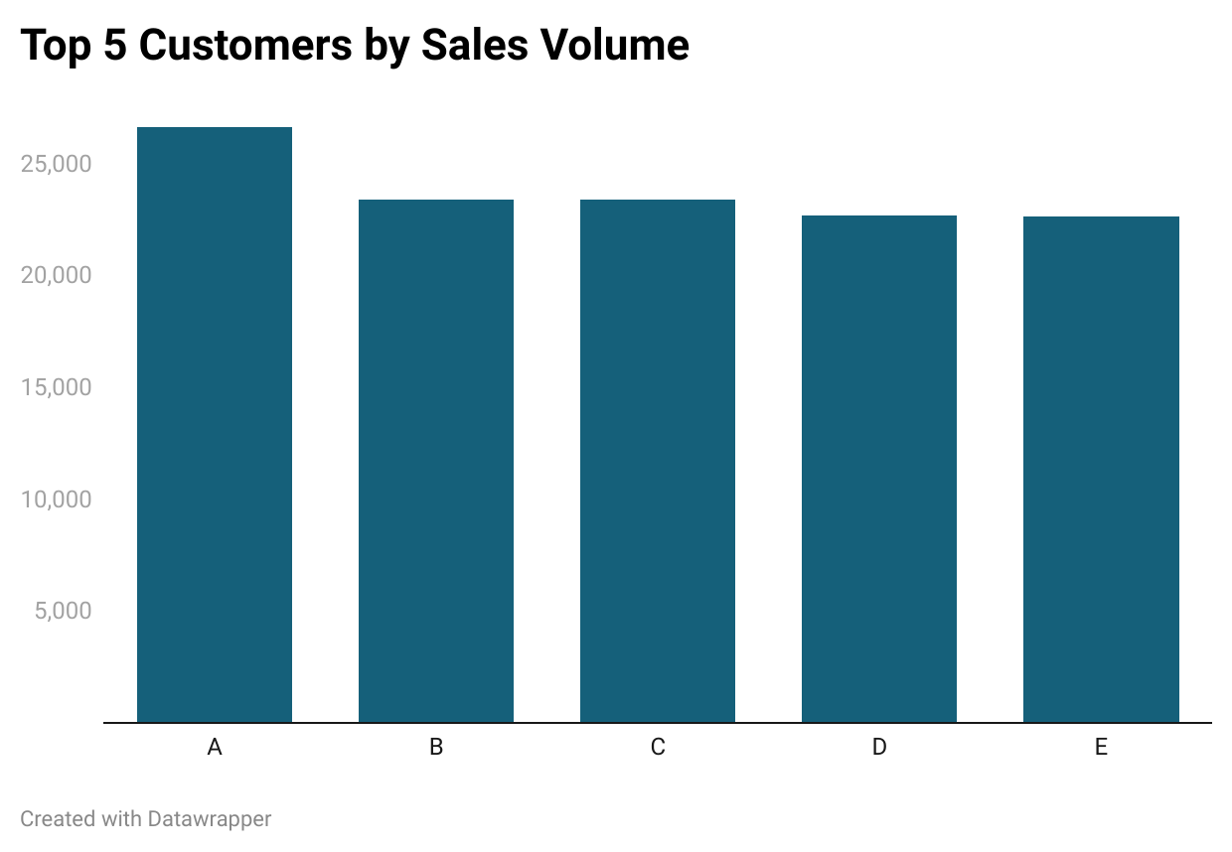
Top 5 Customers By Sales Volume
Key Insights:
Identifies top 5 customers who have spent the most.
Provides insights into high-value customers contributing the most to revenue.
Top Findings:
Customers with the highest total spending.
Potential VIP customers for targeted loyalty programs and premium offers.
Bar Chart : Displays top 5 customers and their total spending.
Segmentation: Helps categorize high-spending customers for personalized engagement.
Helps in crafting exclusive offers for top customers.
Optimizes customer retention strategies through rewards and premium services.
Enhances revenue forecasting by understanding high-spending patterns.

Slide 23
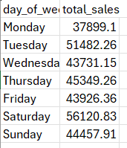
Sales Trends by Day of the Week
SQL Query
SELECT DAYNAME(date) AS day_of_week, SUM(total) AS total_sales
FROM sales
GROUP BY day_of_week
ORDER BY FIELD(day_of_week, 'Monday', 'Tuesday', 'Wednesday', 'Thursday', 'Friday', 'Saturday', 'Sunday');
Out put

Slide 24
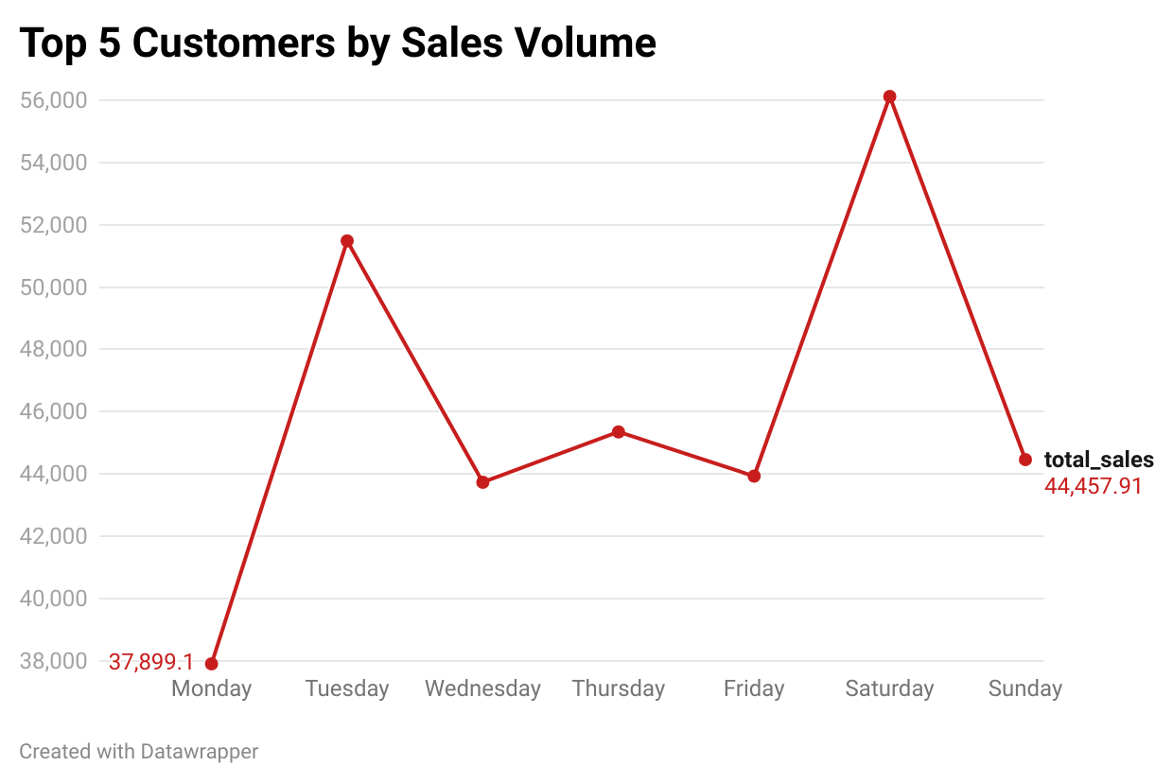
Sales Trends By Day Of The Week
Key Insights:
Identifies sales distribution across different days of the week.
Helps understand peak sales days and optimize business operations.
Top Findings:
Sales fluctuate across the week, with some days performing better.
Identifies high-traffic days for better resource allocation.
Line Chart : Displays total sales by day of the week.
Trend Analysis: Helps in spotting patterns for demand forecasting.
Aids in workforce and inventory management based on peak sales days.
Supports marketing strategies by targeting high-revenue days.
Enhances decision-making for promotions and discount planning.

Slide 25
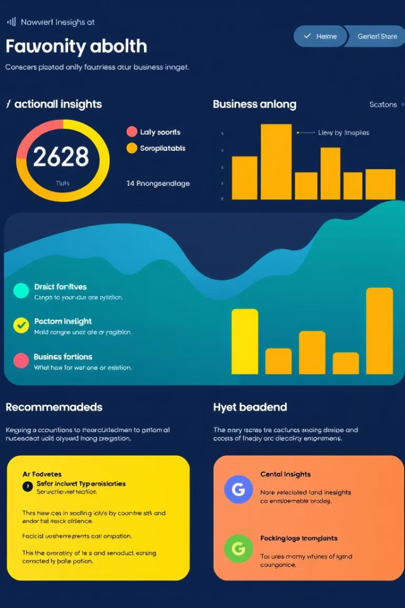
Insights & Recommendations
My analysis reveals key opportunities for Walmart to enhance sales performance. The identified top-performing branch provides a benchmark for operational excellence, while the most profitable product line highlights areas for strategic investment. Understanding customer spending patterns allows for targeted marketing initiatives to maximize customer lifetime value. These insights, when implemented, will improve efficiency and drive revenue growth.

Slide 26


Quick intro about project
https://drive.google.com/file/d/1MOzgTGfhPiTzcObKtF63bh6jEUXNfUcx/view?usp=sharing

Slide 27
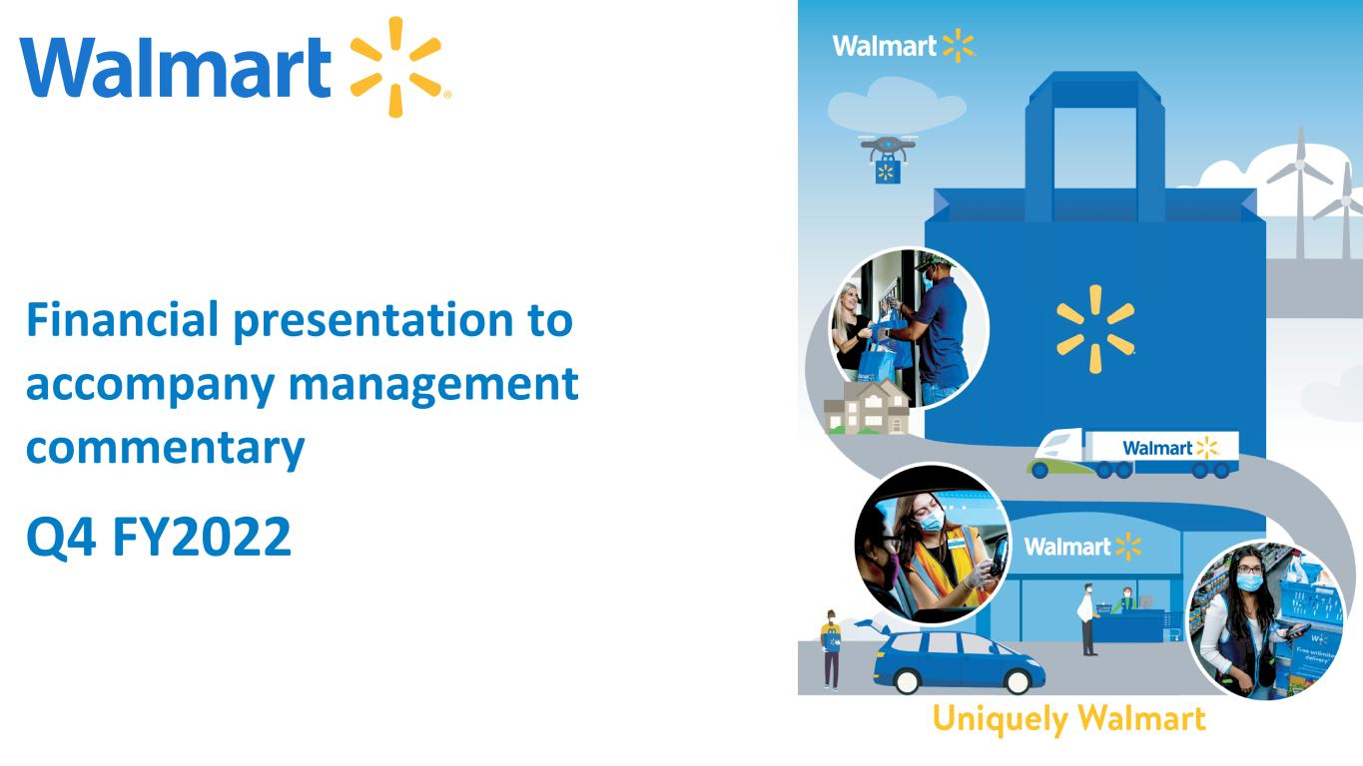
Conclusion
This project demonstrated the power of SQL techniques for analyzing sales data and extracting valuable insights. By leveraging these insights, Walmart can make data-driven decisions to improve sales performance, enhance customer experience, and drive business growth.

Slide 28
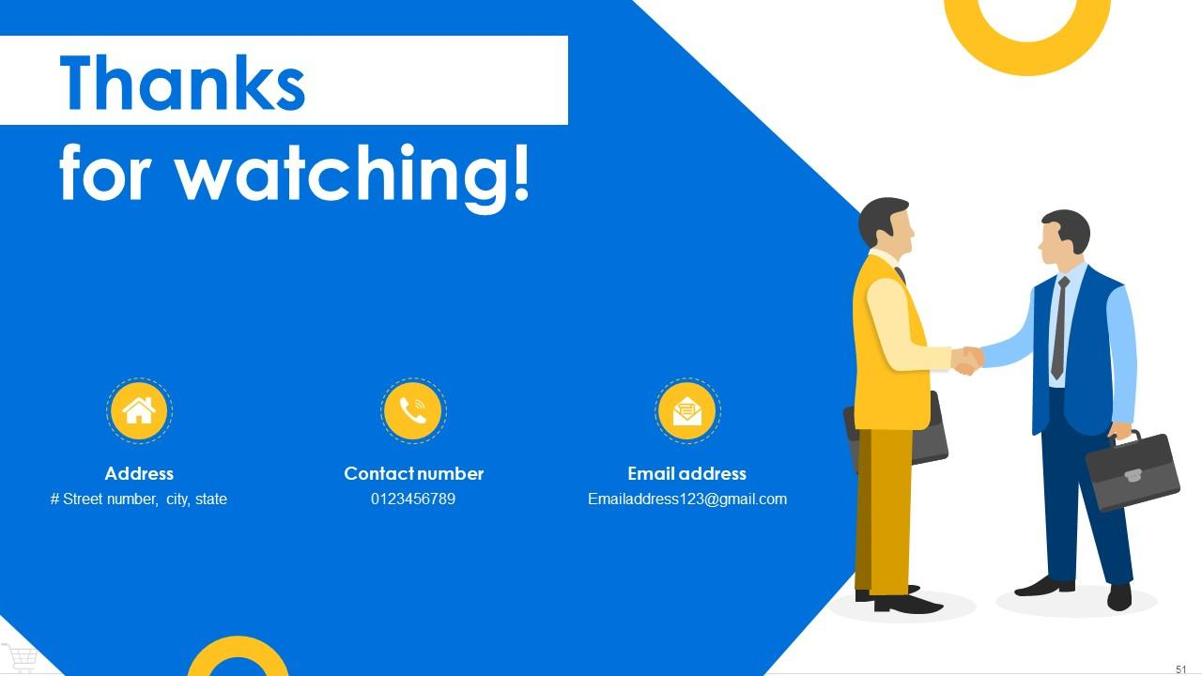
THANK YOU

